Slide 1

College of Business
DA_6813_001 Fall 2022
Visa certification
By: Narges Shahmohammadi Heydari

Slide 2
Contents
In this presentation, we are going to get deep into Visa certification and elements that are effective on visa certification and denial of visas.
Business communities in the United States are facing high demand for human resources. Still, one of the constant challenges is identifying and attracting the right talent, perhaps the most essential element in remaining competitive. Companies in the United States look for hard-working, talented, and qualified individuals both locally as well as abroad.
Office of Foreign Labor Certification (OFLC) processes job certification applications for employers seeking to bring foreign workers into the United States and grants certifications in those cases where employers can demonstrate that there are not sufficient US workers available to perform the work at wages that meet or exceed the wage paid for the occupation in the area of intended employment.
UTSA • San Antonio, Texas 78249

Slide 3
Business Problem Overview and Solution Approach
The increasing number of applicants every year calls for a Machine Learning based solution that can help in shortlisting the candidates having higher chances of VISA approval.
We as a data scientist at Easy-Visa must analyze the data provided and, with the help of a classification model:
Facilitate the process of visa approvals.
find a suitable profile for the applicants for whom the visa should be certified or denied based on the drivers that significantly influence the case status.

Slide 4
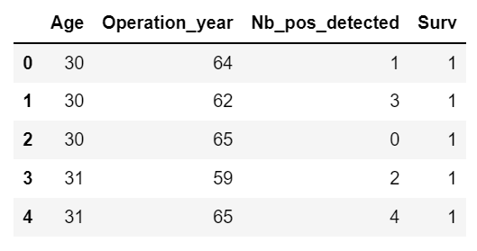
Some details of data
The data has 306 rows and 4 columns:
Age: Age of patient at time of operation
Operation_year is about Patient's year of operation for example…
The next column contains the Number of positive axillary nodes detected
The last column is Survival status (class attribute) 1 = the patient survived 5 years or longer 2 = the patient died within 5 year
There is no missing value
All variables are numerical
UTSA • San Antonio, Texas 78249

Slide 5
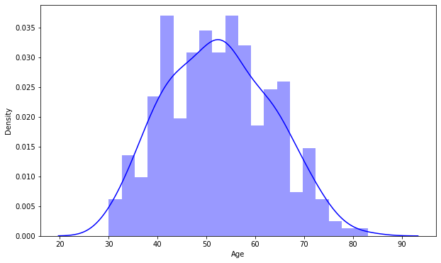
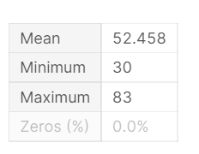
Distribution of column Age
It looks like a normal distribution
The mean is 52 years
The minimum is 30 years old
The maximum is 83 years old
UTSA • San Antonio, Texas 78249

Slide 6
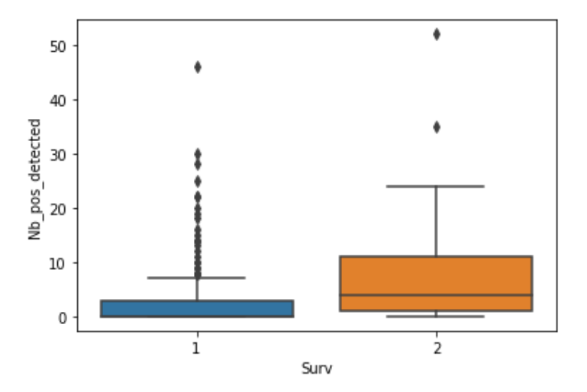
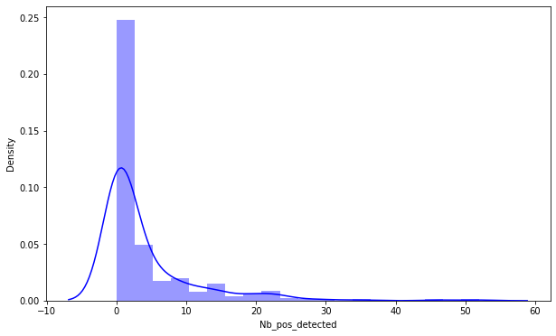
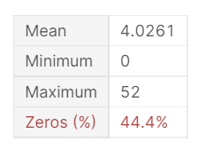
From box plot we can see that Patients who have more nodes are less likely to survive.
Distribution of Number of positive axillary nodes (lymph nodes)
UTSA • San Antonio, Texas 78249

Slide 7
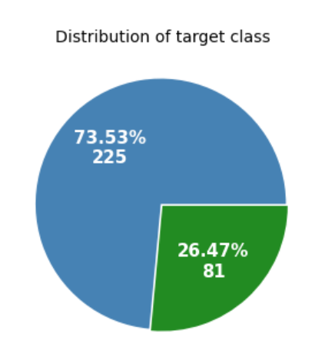
Pie chart of the event survival status
Blue = the patient survived 5 years or longer
Green= the patient died within 5 year
There are 225 patients out of 306 were survived more than 5 years and only 81 patients survived less than 5 years.
UTSA • San Antonio, Texas 78249

Slide 8
Survival Analysis – methods
The survival analysis is based on the probability that the event of interest has not occurred at time t.
The Kaplan Meier Estimator measures the fraction of subjects who survived for a certain amount of survival time t. Before using KM estimate in survival analysis, three assumptions must be made:
Subjects that are censored have the same survival prospects as those who continue to be followed.
Survival probability is the same for all the subjects, irrespective of when they are recruited for the study
The event of interest happens at the specified time.
UTSA • San Antonio, Texas 78249

Slide 9
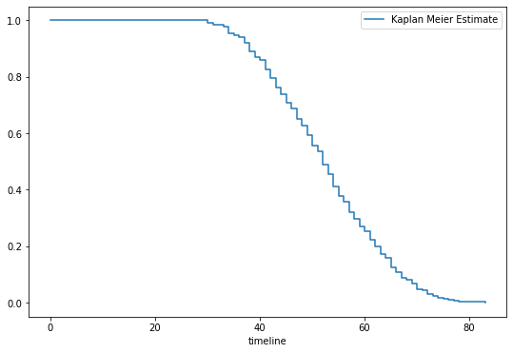
the y-axis represents the probability the patient still hasn’t experienced the event of interest after time t , where time t is on the x-axis. The K-M curve takes a step down when there is an event.
Kaplan-Meier Plot
As you can see it’s difficult to describe how individuals differ in their survival functions based on the profiles. The main way to do it, is to fit a different model on different subpopulations and compare them
UTSA • San Antonio, Texas 78249
Notes:
The key idea of the Kaplan-Meier estimator is to break the estimation of the survival function S(t) into smaller steps depending on the observed event times

Slide 10
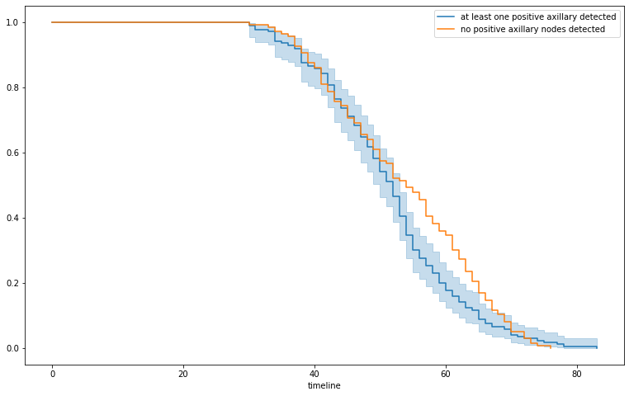
Survival curve
There are two survival curves, the orange one for groups that have no positive axillary nodes detected, and the blue one for groups with at least one axillary node.
From the curves, it is evident that patients, who have at least 1 axillary node, are more likely to die sooner, although they had surgery.
Before 45 years old, the two curves are almost overlapped.
At any point t>45 across the timeline, we can see that the survival probability of the cohort in blue is less than the cohort in orange.
UTSA • San Antonio, Texas 78249

Slide 11
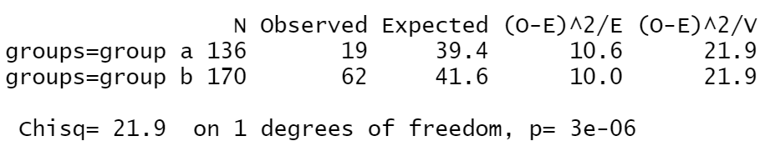
Log-rank Test
Null hypothesis (H₀): There is no difference in survival between the two groups.
Alternative Hypothesis (H₁): There is a difference in survival between the two groups.
Group a (has no axillary node)
Group b ( at least one axillary node has been detected)
The Chi-Squared test statistic is 21.9 with 1 degree of freedom and the p-value (3e-06) is less than .05, so, we reject the null hypothesis and say: There is a difference in survival between the two groups
UTSA • San Antonio, Texas 78249

Slide 12
Conclusion
Compare Group a Vs Group b:
by the visual comparison of Survival Curves, we can infer that most of the participants of the group (b) who had at least one axillary node, died during the age of 45-80 but, group (a) had a higher survival chance during the same period.
It seems that surgery is not helpful. in fact, the number of axillary nodes is more important in this issue.
UTSA • San Antonio, Texas 78249

Slide 13
Thank you
Notes:
Add icons for each department.

